Slide 1

National Research University Higher School of Economics Faculty of Computer Science
Master’s Programme ‘System and Software Engineering’
An application for OPTICAL FLOW ESTIMATION BASED ON DEEP LEARNING APPROACHES
Student: Attakorah Joseph Afriyie
Supervisor: Professor Hadi Saleh
Moscow, 2020

Slide 2

Faculty of Computer Science / Master’s Programme ‘System and Software Engineering’
INTRODUCTION
Images have special characteristics;
Videos have specific temporal resolution characteristics i.e. frame per second (fps);
Optical Flow is the pattern of apparent motion of an object in a visual scene caused by the relative motion between an observer and the scene;
Computer Vision technique.

Slide 3
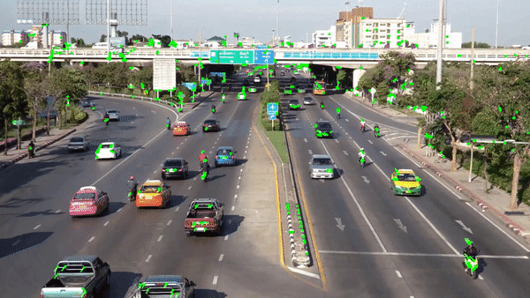
Faculty of Computer Science / Master’s Programme ‘System and Software Engineering’
Description of Subject AREA
Figure 1, Scene [5]

Slide 4
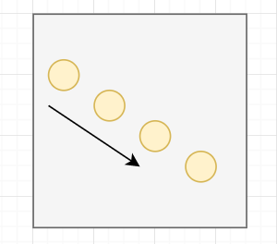
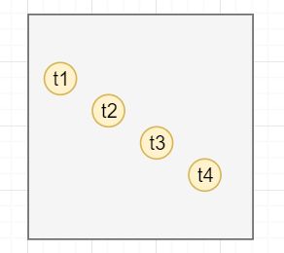
Optical Flow
An object moves from the top left to bottom right
Figure 2.a. Direction of Object.
Figure 2.b. Time sequence of Object.

Slide 5
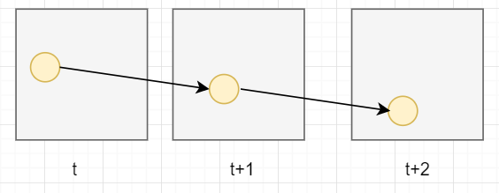
Optical Flow: Video frames
Figure 3. Displacement across frames.

Slide 6
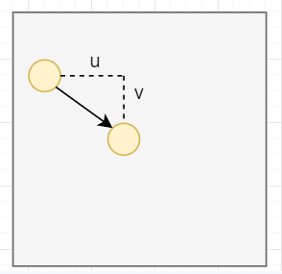
Optical Flow Estimation Problem
Figure 4. Determining Displacement.

Slide 7
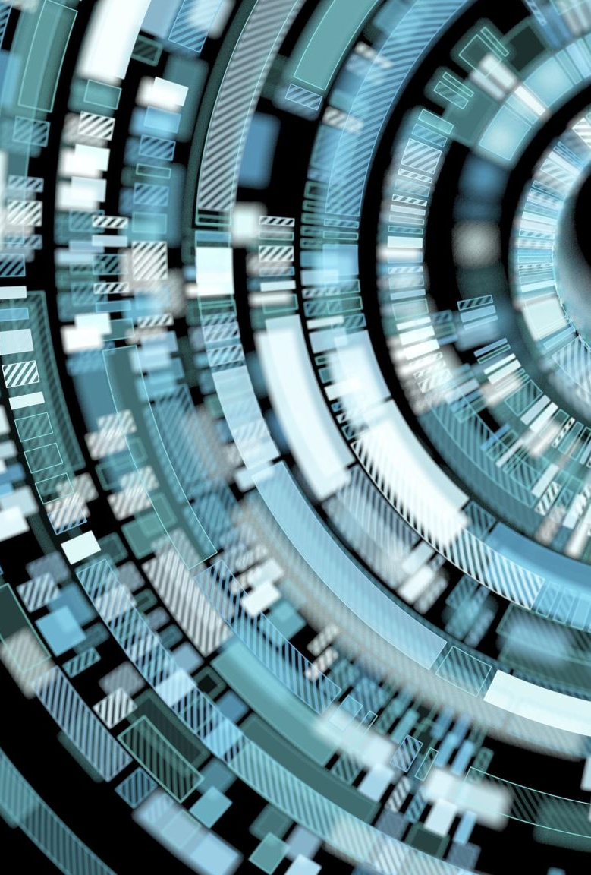
Optical Flow Estimation Problem
- The problem of optical flow has historically been an optimization problem in computer vision
- Recent approaches by applying deep learning have shown impressive results.
Motivation & Relevance
Motion detection and motion estimation and video compression have developed as a major aspect of optical flow research

Slide 8
Faculty of Computer Science / Master’s Programme ‘System and Software Engineering’
Research question
How well do neural networks perform at predicting the speed of a car given a dashcam video?
Objective
To increase the accuracy of estimating the speed of a moving car from video.
Tasks
Review related works
Understand and prepare the dataset
Use deep learning approaches, pytorch and tensorFlow libraries to create a model
Train the model
Predict the speed of a vehicle from a vehicle dashboard camera video.
Document work done

Slide 9
State of the art
Traditional Methods
Technology | Year | Advantages | Limitations
Determining optical flow. Artificial intelligence, Horn, B. K., & Schunck [7] | 1981 | Yields a high density of flow vectors, i.e. the flow information missing in inner parts of homogeneous objects is filled in from the motion boundaries | Complex and computationally expensive in real-time applications. It is more sensitive to noise than local methods
Lucas Kanade method regarding image patches and an affine model for the flow field [6] | 1981 | Very fast calculation and accurate time derivatives | Manually tune all parameters, hence low scalability and errors on boundaries of moving object

Slide 10
State of the art
Technology | Year | Advantages | Limitations
FlowNetCorr[4] | 2015 | Faster rendering speed than traditional computer vision methods | Two images are convoluted separately and are combined by a correlation layer. Poor performance on displacement
Flownet: Learning optical flow with convolutional networks. (FlowNetS) [2] | 2015 | Faster rendering speed than traditional computer vision methods | simply stacks two sequentially adjacent images as input. Produces noisy and blurred results
FlowNet 2.0: Evolution of Optical Flow Estimation with Deep Networks [1] | 2016 | stacked by FlowNetS and flownetcorr and produces much better results. Based on FlowNet | FlowNet 2.0 is only marginally slower than the original FlowNet although decreases the estimation error by more than 50%
Optical Flow Estimation using a Spatial Pyramid Network (Spynet) [3] | 2016 | much more lightweight, with fewer parameters, faster, and produces large motions in a course to fine manner | performs below FlowNet2.0

Slide 11
Faculty of Computer Science / Master’s Programme ‘System and Software Engineering’
State of the Art – Continue...
Vehicle tracking and speed estimation using optical flow [10]
Fixed mounted camera
Calculate the distance travelled by the vehicle by using the motion of the centroid over the successive frames
Estimate speed using the Horn-Schunck method
Fairly low percentage error of 0.98%
Can only be applied to a fixed setting which limits its range of use-cases

Slide 12
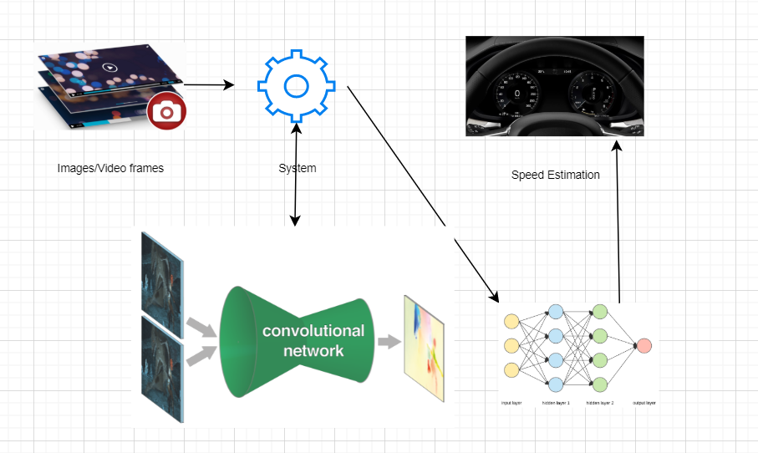
Faculty of Computer Science / Master’s Programme ‘System and Software Engineering’
Proposed approach
Figure 5, System approach

Slide 13







Faculty of Computer Science / Master’s Programme ‘System and Software Engineering’
Tools and technologies
Figure 6, Technologies

Slide 14
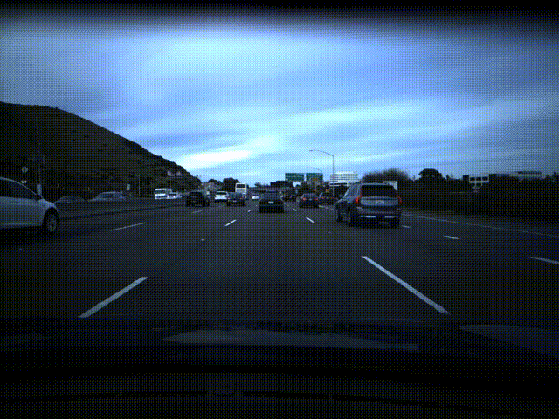
Faculty of Computer Science / Master’s Programme ‘System and Software Engineering’
Methods and Algorithms And Technologies
Figure 7, Sample Kitti dataset [1]
SpyNet Architecture
Data sets:
MPI Sintel and KITTI optical flow 2015
Comma.ai speed challenge dataset (train.mp4, test.mp4, train.txt) [8].
Figure 8, Video dataset

Slide 15
Faculty of Computer Science / Master’s Programme ‘System and Software Engineering’
Expected Results And evaluation
A software program that estimates the speed of a vehicle from a dashcam video
- The solution approach should be able to estimate the speed of a vehicle from a dashcam video;
- Our model is evaluated using the Mean Sqaured Error (MSE), <10 is good, <5 is better and <3 is best.

Slide 16
Faculty of Computer Science / Master’s Programme ‘System and Software Engineering’
Solution approach
Break down the video into individual frames (480x640)
Adjust the image to minimize the amount of unnecessary dynamic and static background that may impact the discernment of relevant features.
Apply a brightness contrast
Determine the Region of Interest (ROI)
Generate optical flow
Convert the flo files to color images
Resize the images (240x320)
Divide the dataset into training and validation dataset (15%)
Feed it to the CNN for training
Predict the speed of car in the test video

Slide 17
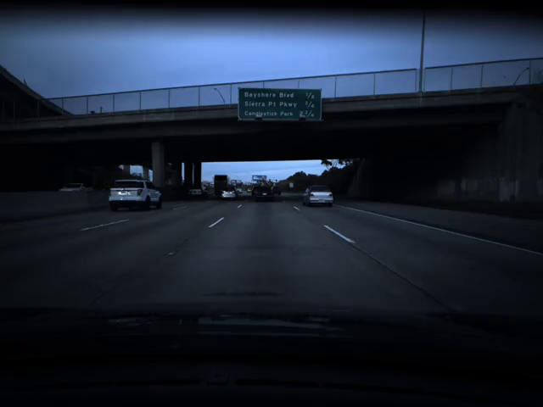
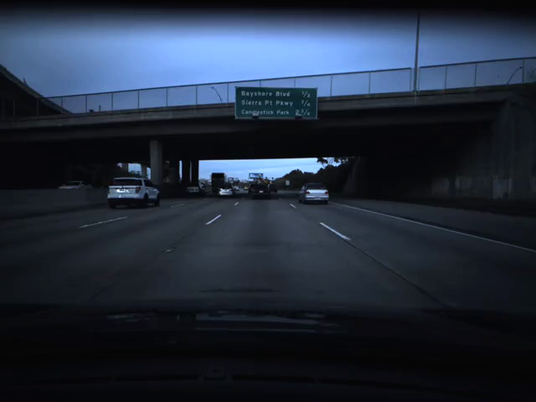

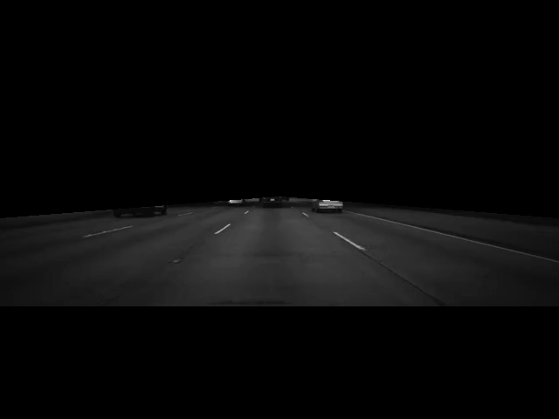
Faculty of Computer Science / Master’s Programme ‘System and Software Engineering’
Solution approach – Image Adjustment i
1
2
Figure 9. Image adjustements
480x640
3
4

Slide 18

Faculty of Computer Science / Master’s Programme ‘System and Software Engineering’
Solution approach – image adjustment ii
.flo files
240x320
Figure 10. Optical flow image

Slide 19
Faculty of Computer Science / Master’s Programme ‘System and Software Engineering’
Solution approach – dataset division
Total Images: 20696
Train samples: 16556
Validation samples: 4140
Number of labels: 20696

Slide 20
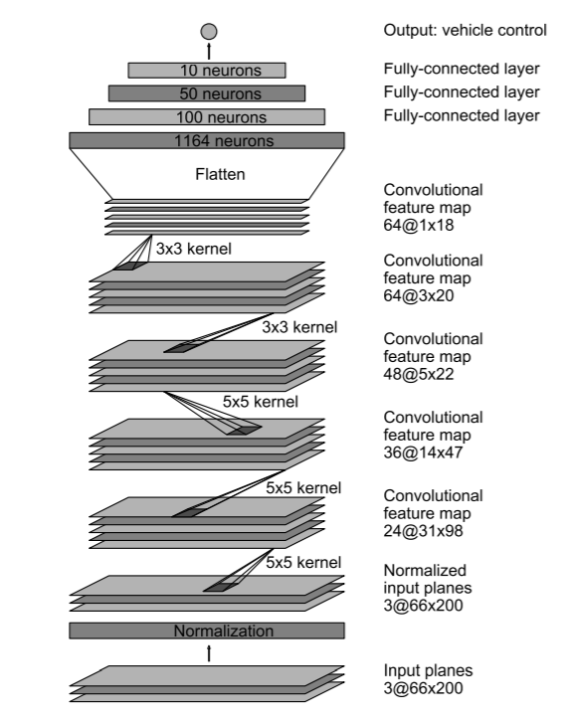
Faculty of Computer Science / Master’s Programme ‘System and Software Engineering’
Solution approach
Figure 11. NVIDIA CNN architecture for End to End learning for self-driving cars [9]
Training done on ubuntu 18.04 with a NVIDIA GEFORCE GTX 1060 Cuda Enabled GPU using this architecture which is continually adjusted for better results.

Slide 21
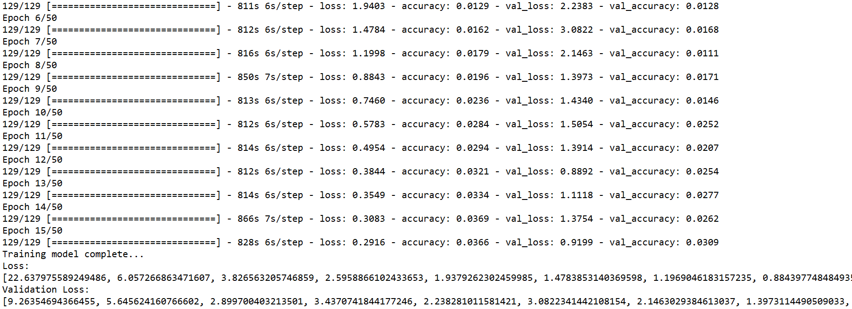
Faculty of Computer Science / Master’s Programme ‘System and Software Engineering’
Current results
Figure 12. Training result 1

Slide 22
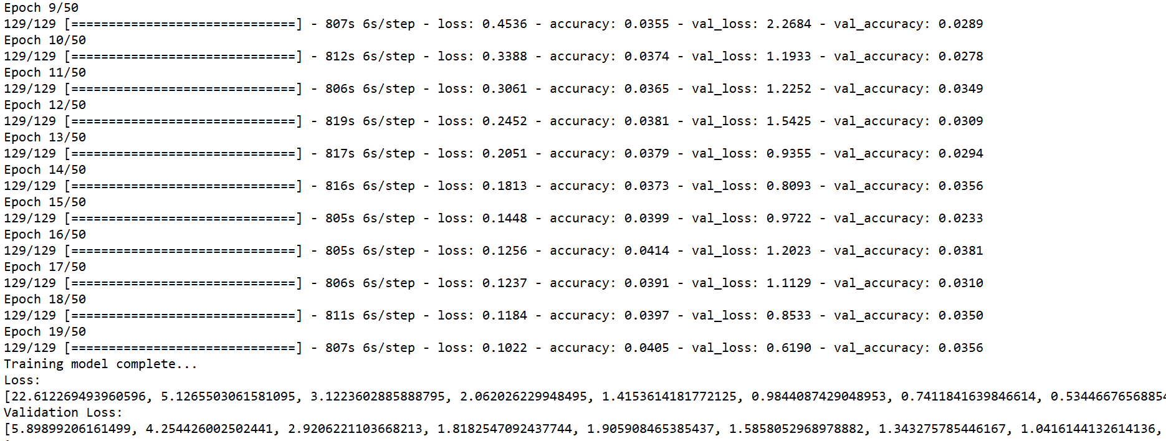
Faculty of Computer Science / Master’s Programme ‘System and Software Engineering’
Current results – After some adjustments
Figure 13. Training result 2

Slide 23
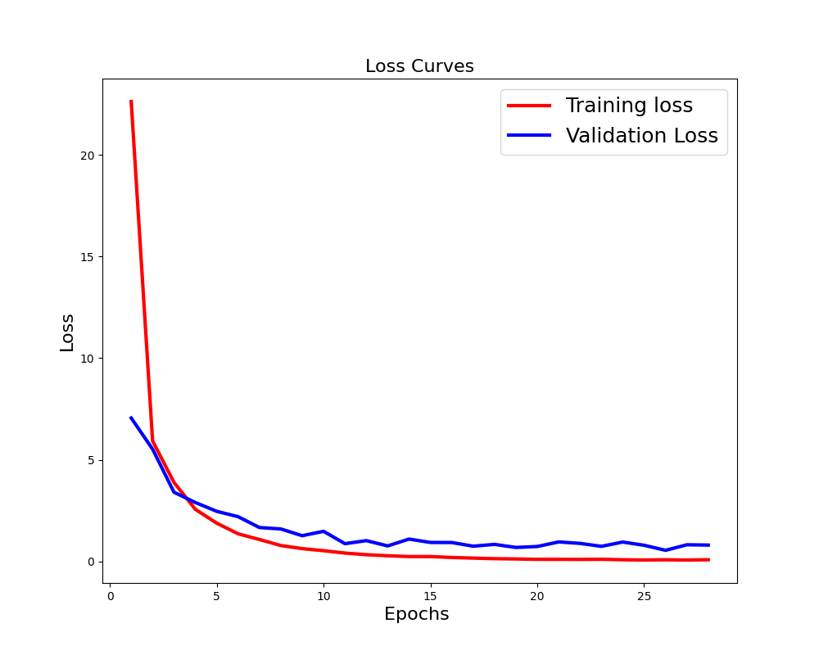
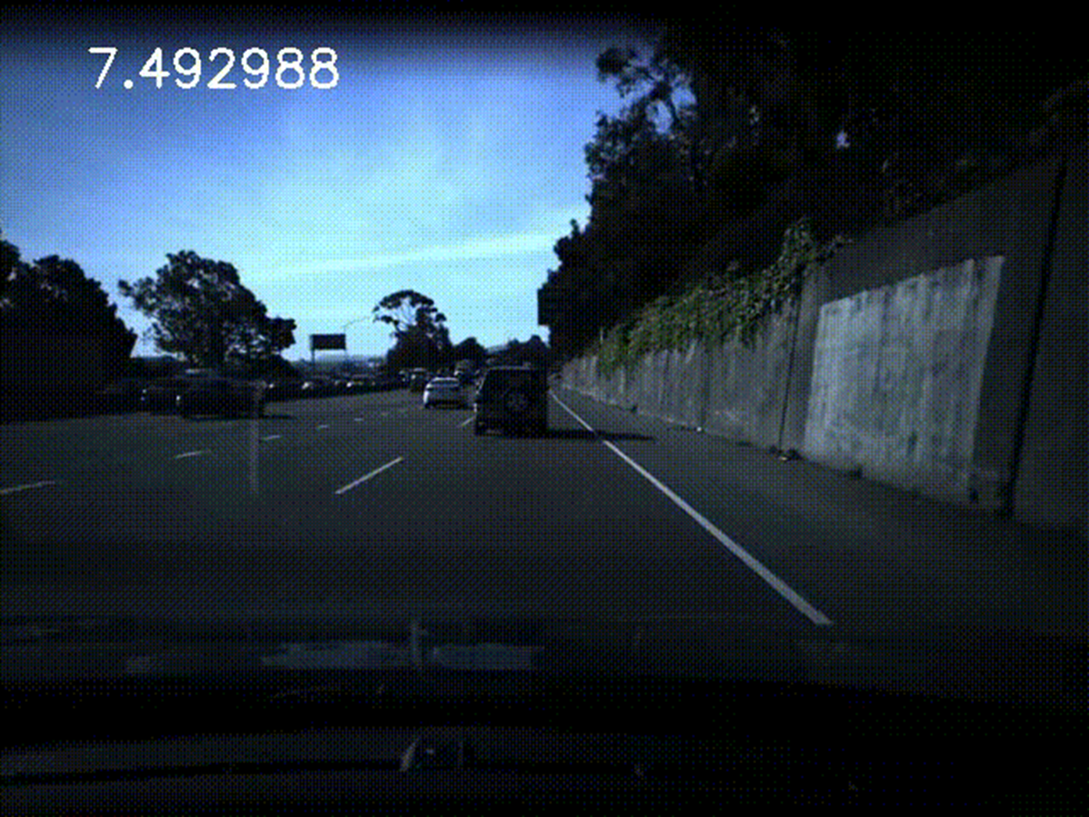
Faculty of Computer Science / Master’s Programme ‘System and Software Engineering’
Current results
Figure 13. Loss Curves
Figure 14. Prediction

Slide 24
Faculty of Computer Science / Master’s Programme ‘System and Software Engineering’
status of Progress – 87.5%
Review related works – 95%
Understand and prepare the dataset – 100%
Use deep learning approaches, pytorch and tensorFlow library to create a model – 90%
Train – 85%
Predict the speed of a vehicle from video - 85%
Document work done – 70%

Slide 25
Faculty of Computer Science / Master’s Programme ‘System and Software Engineering’
Next step – Adjustments
“Our model is evaluated using the Mean Sqaured Error (MSE), <10 is good, <5 is better and <3 is best “
10 > Current MSE > 5
Further Image augmentation/Model adjustments

Slide 26
Faculty of Computer Science / Master’s Programme ‘System and Software Engineering’
Reference
[1] Ilg, E., Mayer, N., Saikia, T., Keuper, M., Dosovitskiy, A., & Brox, T. (2017). Flownet 2.0: Evolution of optical flow estimation with deep networks. In Proceedings of the IEEE conference on computer vision and pattern recognition (pp. 2462-2470).
[2] Dosovitskiy, A., Fischer, P., Ilg, E., Hausser, P., Hazirbas, C., Golkov, V., ... & Brox, T. (2015). Flownet: Learning optical flow with convolutional networks. In Proceedings of the IEEE international conference on computer vision (pp. 2758-2766).
[3] Sun, D., Yang, X., Liu, M. Y., & Kautz, J. (2018). PWC-Net: CNNs for optical flow using pyramid, warping, and cost volume. In Proceedings of the IEEE Conference on ComputerVision and Pattern Recognition (pp. 8934-8943).
[4] Menze, M., & Geiger, A. (2015). Object scene flow for autonomous vehicles. In Proceedings of the IEEE
[5] Chuan-en Lin, 2019, Introduction to Motion Estimation with Optical Flow, Retrieve from https://nanonets.com/blog/optical-flow/
[6] B. D. Lucas and T. Kanade (1981), An iterative image registration technique with an application to stereo vision. Proceedings of Imaging Understanding Workshop, pages 121—130
[7] B.K.P. Horn and B.G. Schunck, "Determining optical flow." Artificial Intelligence, vol 17, pp 185–203, 1981. Manuscript available on MIT server
[8] George Hotz, 2018, The comma.ai Speed Prediction Challenge, retrieved from https://github.com/commaai/speedchallenge
[9] Mariusz Bojarski, Davide Del Testa, Daniel Dworakowski, Bernhard Firner, Beat Flepp, Prasoon Goyal, Lawrence D. Jackel, Mathew Monfort, Beat Flepp, Prasoon Goyal, Lawrence D. Jackel, Mathew Monfort, Urs Muller, Jiakai Zhang, Xin Zhang, Jake Zhao, Karol Zieba, (2016), End to End Learning for Self-Driving Cars, arXiv:1604.07316
[10] S.Indu, Manjari Gupta and Prof. Asok Bhattacharyya, 2011. Vehicle tracking and speed estimation using optical flow method. ISSN: 0975-5462
Link to code repository - https://github.com/jizzel/Optical-Flow-Estimation-Based-on-Deep-Learning-Approaches

Slide 27
Thank You for attention
Thanks to Shadi Saleh from Germany
Address: 20 Myasnitskaya Ulitsa, Moscow 101000 Russia | 11 Pokrovsky Boulevard, Moscow 109028 Russia

